Slide 1

CSE716:Advanced Database
Lecture by A.M.Esfar-E-Alam

Slide 2

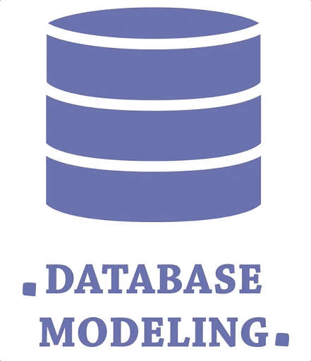
TOPICS
Please write your great title is here
Data Modeling
Object Oriented Data Modeling Here
Description here:
20%
Description here:
80%

Slide 3

Data Modeling
Data modelling is the first step in the process of database design. This step is sometimes considered to be a high-level and abstract design phase, also referred to as conceptual design. The aim of this phase is to describe:
The data contained in the database (e.g., entities: students, lecturers, courses, subjects)
The relationships between data items (e.g., students are supervised by lecturers; lecturers teach courses)
The constraints on data (e.g., student number has exactly eight digits; a subject has four or six units of credit only)

Slide 4
In the database design phases, data are represented using a certain data model.
The data model is a collection of concepts or notations for describing data, data relationships, data semantics and data constraints.
Most data models also include a set of basic operations for manipulating data in the database.

Slide 5

Types of Data Models
There are mainly three different types of data models:
Conceptual: This Data Model defines WHAT the system contains. This model is typically created by Business stakeholders and Data Architects. The purpose is to organize, scope and define business concepts and rules.
Logical: Defines HOW the system should be implemented regardless of the DBMS. This model is typically created by Data Architects and Business Analysts. The purpose is to developed technical map of rules and data structures.
Physical: This Data Model describes HOW the system will be implemented using a specific DBMS system. This model is typically created by DBA and developers. The purpose is actual implementation of the database.

Slide 6

Object-Oriented data Modeling
Here we will get introduced to object-oriented data modeling.
We will describe the main concepts and techniques involved in object-oriented modeling, including objects and classes; encapsulation of attributes and operations; association, generalization, and aggregation relationships; cardinalities and other types of constraints; polymorphism; and inheritance.
We will see show how we can develop class diagrams, using the UML notation, to provide a conceptual view of the system being modeled

Slide 7
Representing objects and classes
In the object-oriented approach, we model the world in objects.
Before applying the approach to a real-world problem, therefore, we need to understand what an object and some related concepts really are.
Class
An entity type that has a well-defined role in the application domain about which the organization wishes to maintain state, behavior, and identity
Object
An instance of a class that encapsulates data and behavior.
state
An object’s properties (attributes and relationships) and the values those properties have.
behavior
The way in which an object acts and reacts.

Slide 8
Class/Object Diagram
We can depict the classes graphically in a class diagram
A class diagram shows the static structure of an object-oriented model: the classes, their internal structure, and the relationships in which they participate.
In UML, a class is represented by a rectangle with three compartments separated by horizontal lines.
The class name appears in the top compartment, the list of attributes in the middle compartment, and
the list of operations in the bottom compartment of a box.
The figure shows two classes, Student and Course, along with their attributes and operations.
There is an object diagram drawn below to class diagram
An object diagram, also known as an instance diagram, is a graph of instances that are compatible with a given class diagram.

Slide 9
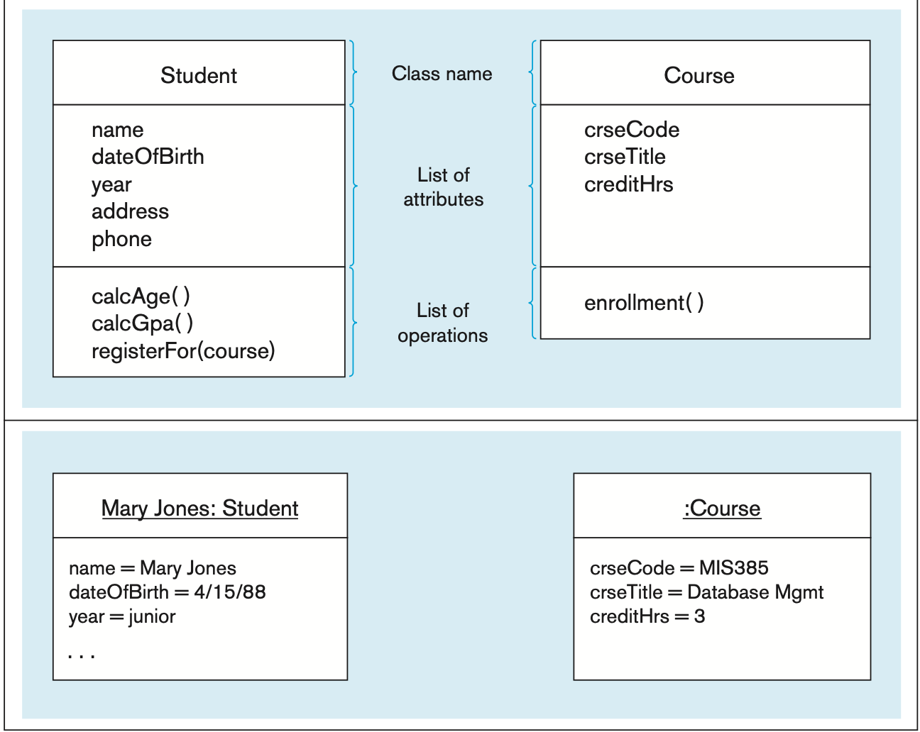
Class Diagram-Object Diagram

Slide 10

Operation and Types of Operation
An operation, such as calcGpa in Student, is a function or a service that is provided by all the instances of a class.
Typically, other objects can access or manipulate the information stored in an object only through such operations
Operations can be classified into four types, depending on the kind of service requested by clients: (1) constructor, (2) query, (3) update, and (4) class-scope

Slide 11
constructor operation :
An operation that creates a new instance of a class.
Query operation
An operation that accesses the state of an object but does not alter the state.
Update operation
An operation that alters the state of an object.
class-scope operation
An operation that applies to a class rather than to an object instance.

Slide 12

Association
Parallel to the definition of a relationship for the E-R model, an association is a named relationship between or among instances of object classes.
As in the E-R model, the degree of an association relationship may be one (unary), two (binary), three (ternary), or higher (n-ary).
An association is shown as a solid line between the participating classes. The end of an association where it connects to a class is called an association role
Multiplicity
A specification that indicates how many objects participate in a given relationship.
Multiplicity is shown using following format lowerBound..upperBound

Slide 13
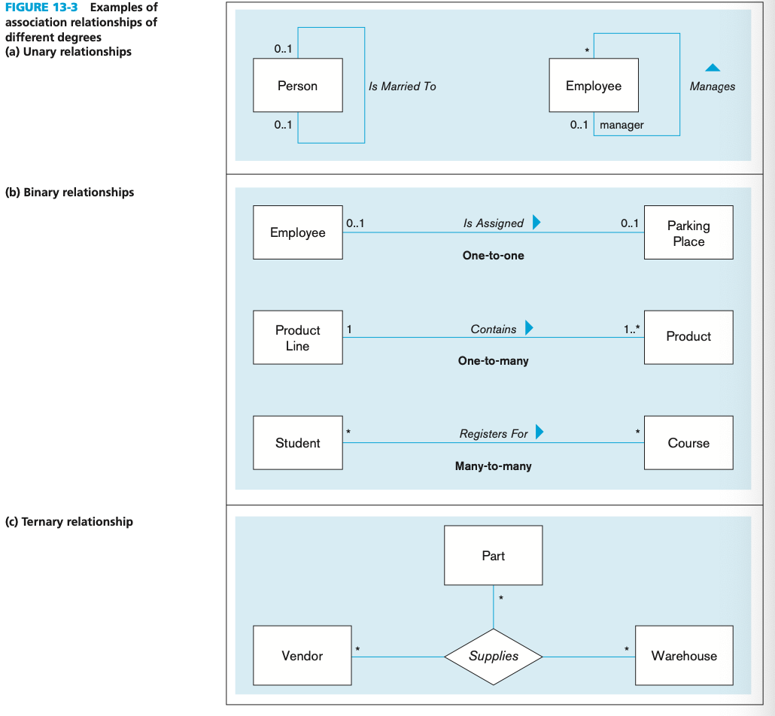

Slide 14
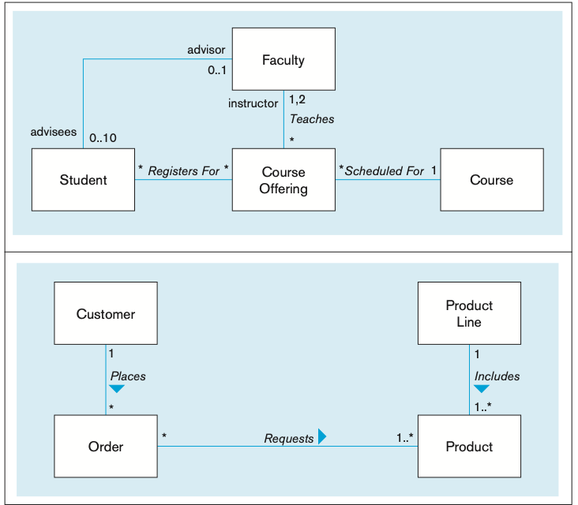
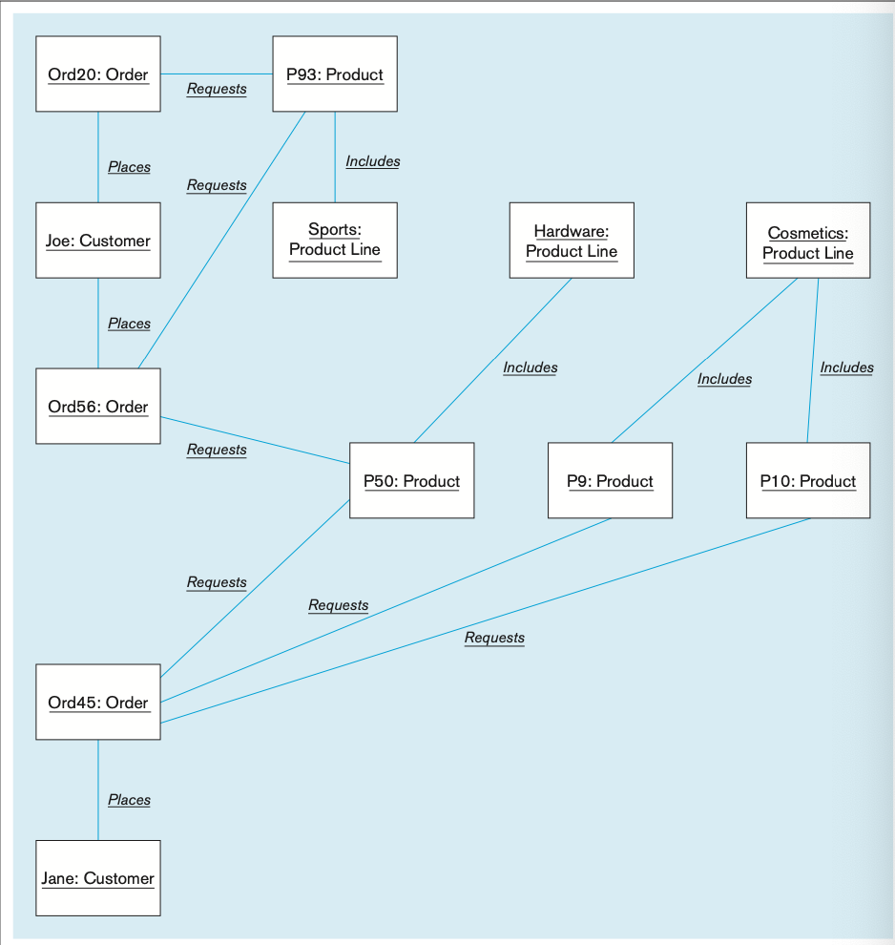

Slide 15
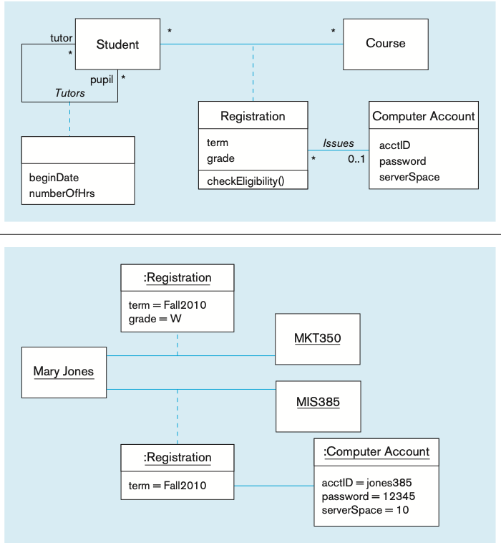
Association Class Representation
When an association itself has attributes or operations of its own, or when it participates in relationships with other classes, it is useful to model the association as an association class
For example, in Figure, the attributes term and grade really belong to the many-to-many association between Student and Course.
The grade of a student for a course cannot be determined unless both the student and the course are known.
Similarly, to find the term(s) in which the student took the course, both student and course must be known.
The checkEligibility operation, which determines whether a student is eligible to reg-ister for a given course
We have also captured the fact that for some course registrations, a computer account is issued to a student

Slide 16
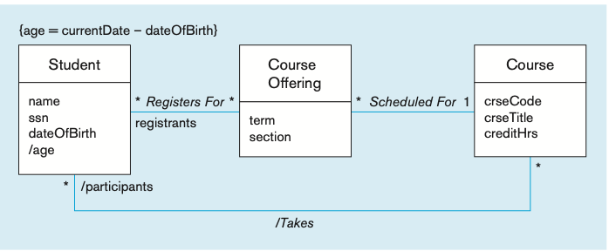
Derived Atrribute
A derived attribute, association, or role is one that can be computed or derived from other attributes, associations, and roles, respectively.
A derived element (attribute, association, or role) is typi- cally shown by placing either a slash (/) or a stereotype of <<Derived>> before the name of the element.
For instance, in Figure , age is a derived attribute of Student, because it can be calculated from the date of birth and the current date.
Relation between Student and Course is also derived

Slide 17

Generalization and Specialization
It is same as ER modeling
As this topics are widely covered in undergrad I assume you are familiar with the idea.
If not please google and refresh your memory as you will be using this concept while drawing data models
You will also have complex question related to generalization and specialization so don’t skip. Ask me if you need help.

Slide 18

Related Terms
When drawing a data model you will come across following : overlapping, disjoint, complete, and incomplete. These terms have the following meanings:
Overlapping A descendant may be descended from more than one of the sub- classes. (This is the same as the overlapping rule in EER diagramming.)
Disjoint A descendant may not be descended from more than one of the sub- classes. (This is the same as the disjoint rule in EER diagramming.)
Complete All subclasses have been specified (whether or not shown). No additional subclasses are expected. (This is the same as the total specialization rule in EER diagramming.)
Incomplete Some subclasses have been specified, but the list is known to be in- complete. There are additional subclasses that are not yet in the model. (This is the same as the partial specialization rule in EER diagramming.)
Overlapping and disjoint are mutually exclusive, as are complete and incomplete. Thus, the following combinations are possible: {complete, disjoint}, {incomplete, disjoint}, {complete, overlapping}, {incomplete, overlapping}

Slide 19
abstract class :A class that has no direct instances but whose descendants may have direct instances.
concrete class :A class that can have direct instances.
class-scope attribute: An attribute of a class that specifies a value common to an entire class rather than a specific value for an instance.
abstract operation: An operation whose form or protocol is defined but whose implementation is not defined.

Slide 20
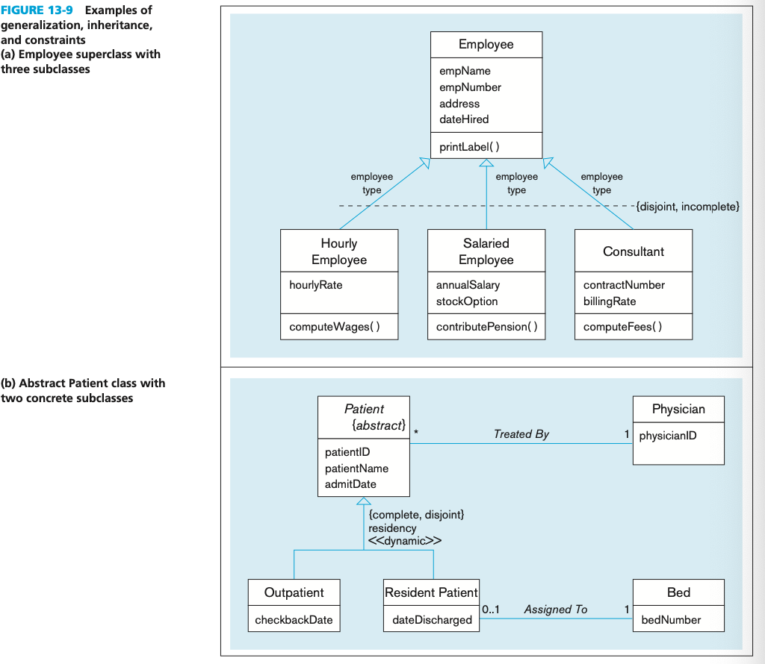

Slide 21
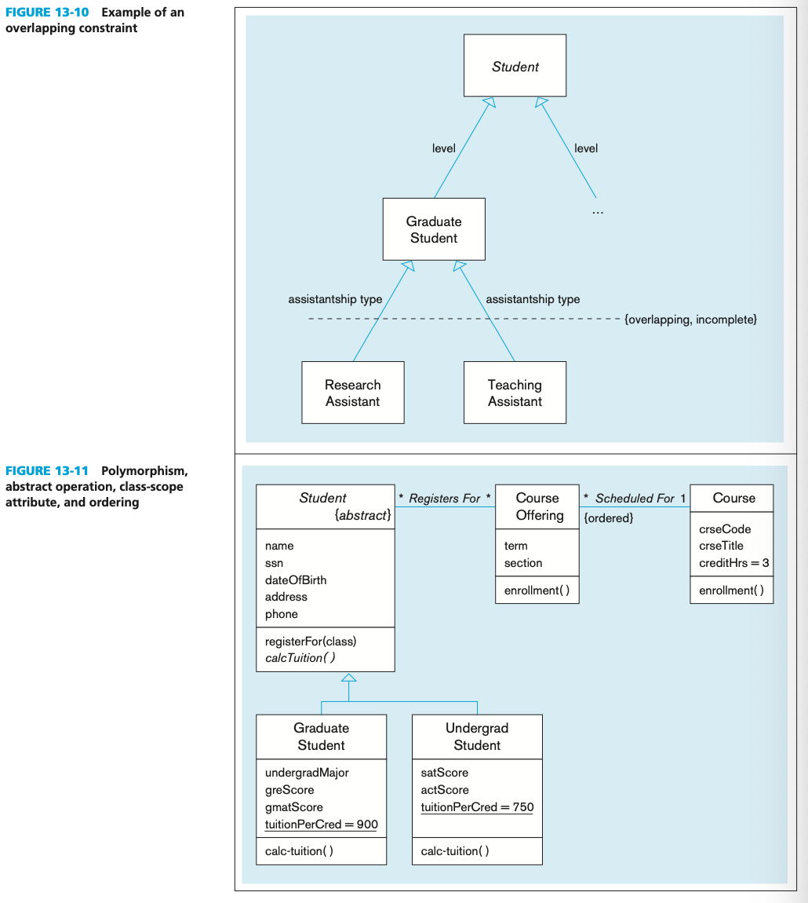

Slide 22
Multiple Inheritance, Aggregation and Composition
Multiple classification
A situation in which an object is an instance of more than one class.
aggregation
A part-of relationship between a component object and an aggregate object. Shown with hollow diamond.
composition
A part-of relationship in which parts belong to only one whole object and live and die with the whole object.
Shown with solid diamond

Slide 23
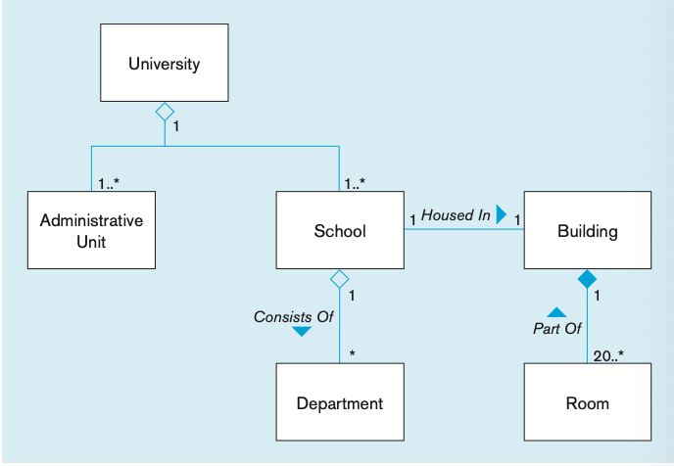
Without building there is no existence of room. Its composition.
School is made of departments. Dept of CSE may still exsists outside dept of engineering
Demolishing a school(i.e:school of engineering) will not demolish dept of CSE.It will go under school of data science or exsist indepedently.

Slide 24
All symbols for Data Modeling

Slide 25
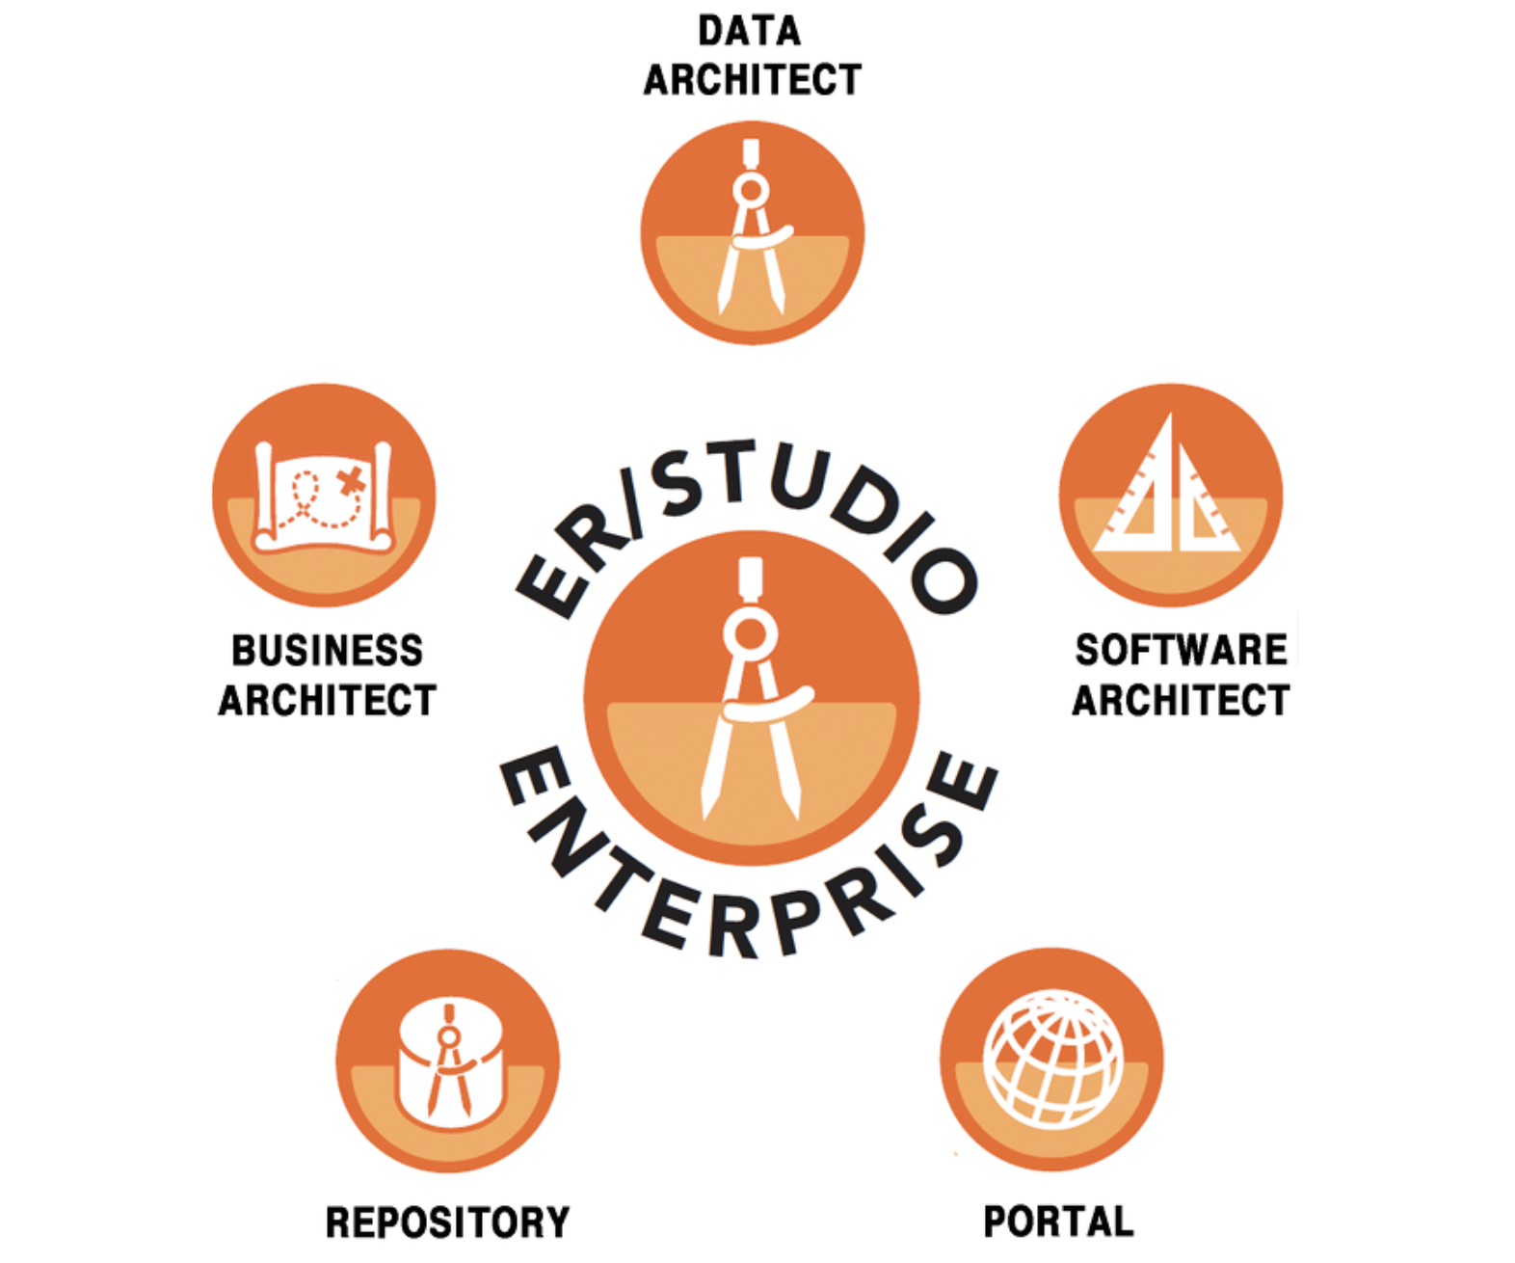


Data Modeling Tools
Lucid Chart: Used by 90% of fortune 500 companies including google and amazon. It is cloud-based and can be accessed via the website only.
ER Studio: ER Studio is an instinctive data modelling tool that supports single and multi-platform environments, along with local integration for big data platforms such as — Hive and Mongo DB.
IBM InfoSphere Data Architect:InfoSphere is a data modelling tool that operates on an open-source platform — which is Eclipse. As eclipse is a very popular IDE it is often used to provide an end to end solution.

Slide 26
Assignment
We want add a data modeling tool to our list of familiar tools in our CV. So open an account on lucid chart
Then you need to make a data model for stars.
Related document is provided check thaqt out to understand the task and data model.

Slide 27
Reading Reference: https://wps.prenhall.com/wps/media/objects/14735/15089538/M13_HOFF2253_11_SE_C13WEB.pdf

Slide 28


